Slide 1
CREDIT EDA CASE STUDY
BY SALONI GUPTA
AND
YASH CHAUHAN

Slide 2
PURPOSE
Credit risk analysis will help the company to make the decision for loan approval based on profile of applicant .
We will use EDA to understand how consumer attributes and loan attributes influence the tendency of default.

Slide 3
Steps
Data understanding
Univariate analysis.
Bivariate Analysis.
Correlation matrix (Analysis).

Slide 4
UNIVARIATE ANALYSIS

Slide 5
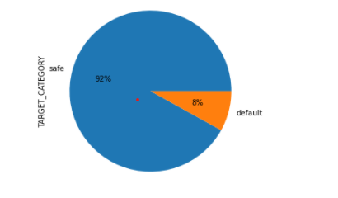
Analyzing Target variable
The percentage of people who were able to pay the loan installments is higher than the defaulters.
92% of people are marked safe , this means 92% of people were able to pay the loan installments on time.
There were only 8% people who were not able to pay the installments on time.

Slide 6
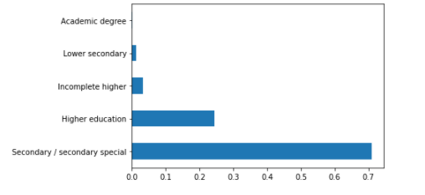
EDUCATION TYPE
The people who have secondary/secondary special have applied for more loans followed by people who have higher education.
The least loans were applied by people who have Academic degree.

Slide 7
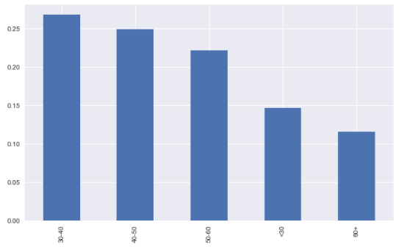
ANALYZING AGE GROUP
Mostly people with age group 30-40 have applied for loans.
Very less amount of loans were applied by retired people , that is, 60+ aged people.
People at young age , that is, having age less than 30 are also applying less loans.

Slide 8
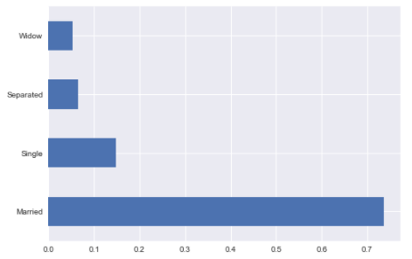
FAMILY STATUS
Married people are applying for more loans followed by single people.
The count of widows and separated is very less.

Slide 9
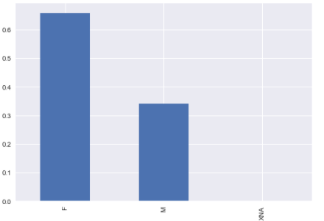
ANALYZING GENDER VARIABLE
The count of female is considerably higher than the count of males.
More females are applying for loans than male.

Slide 10
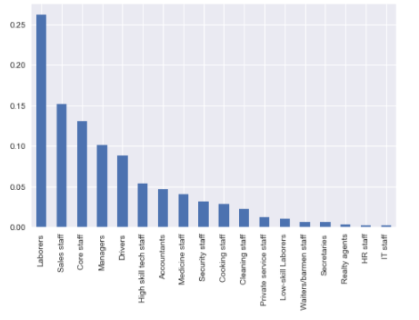
OCCUPATION TYPE
The count of laborers is really high than any other occupation.
Sales staff , core staff , managers, drivers are also applying for loans in high number.
Least count of loans were applied by IT staff , HR staff ,Reality agent , Secretaries and Waller/ bamen staff.

Slide 11
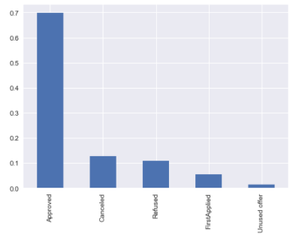
CONTRACT STATUS
More loans were approved .
The loans which are canceled and refused is very less.
Unused offer is considerably less.

Slide 12
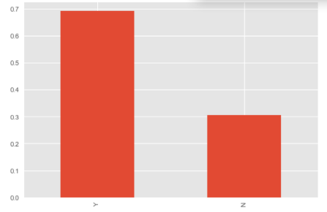
OWNS A HOUSE OR NOT
People owning house have applied more than people who does not owns a house.

Slide 13
BIVARIATE ANALYSIS

Slide 14
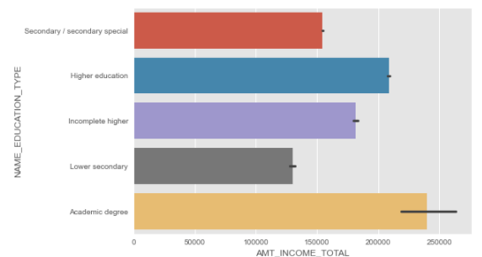
EDUCATION V/S TOTAL INCOME
The people are academic degree are earning more than any education level .
The earning of People having low secondary qualification is really low.

Slide 15
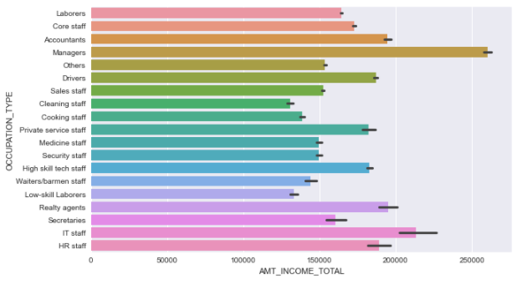
OCCUPATION V/S TOTAL INCOME
Managers have the highest salaries followed by IT staff and Realty agents.
Low- skill laborers and cleaning are most under paid occupation.

Slide 16
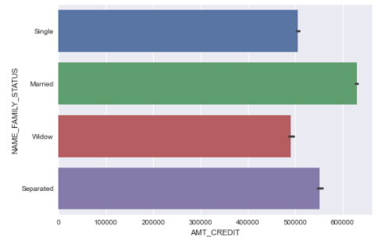
FAMILY STATUS V/S AMOUNT CREDIT
Married people have requested high amount of credit followed by separated people.
Single people and widows have requested almost equal amount of credit.

Slide 17
TARGET CATEGORY V/S OTHER DIMENSIONS

Slide 18
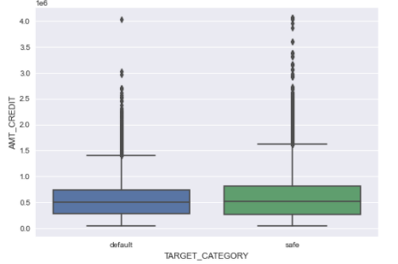
AMOUNT CREDIT V/S TARGET CATEGORY
There are more outliers in safe category than default category.
The median values of amount credit in both the category is almost same.

Slide 19
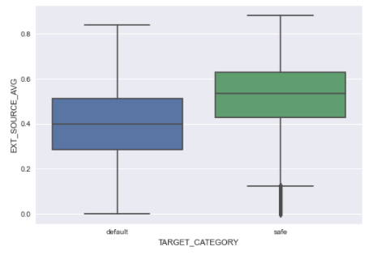
EXTERNAL SOURCE AVERAGE V/S TARGET CATEGORY
The median value of the people who are marked safe is high than the people who are marked as defaulters.
There are no such outliers.

Slide 20
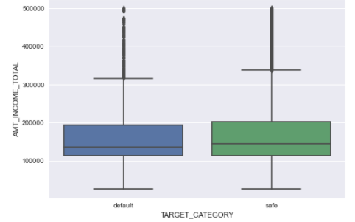
TOTAL INCOME V/S TARGET CATEGORY
Both the graphs are almost same .
The outliers lie in the range 320000 -500000 (appx) for both categories.

Slide 21
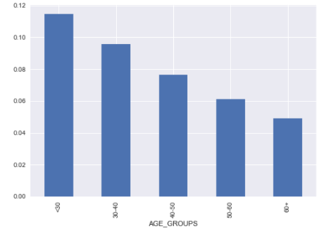
TARGET CATEGORY V/S AGE GROUP
The retired / old people are marked safe that is they have made their loan installments on time.
The people having age less than 30 are marked closed to defaulters that is they were unable to pay loan installments on time.

Slide 22
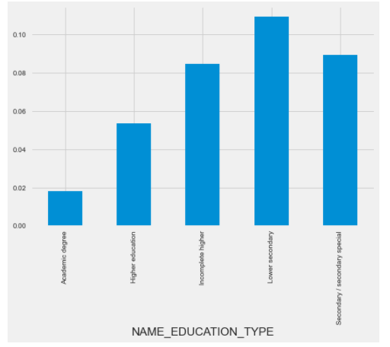
TARGET V/S EDUCATION TYPE
The people with lower secondary qualifications are marked as defaulters , they were unable to pay the loan installments.
The people with academic degree are able to make their loan installments on time.

Slide 23
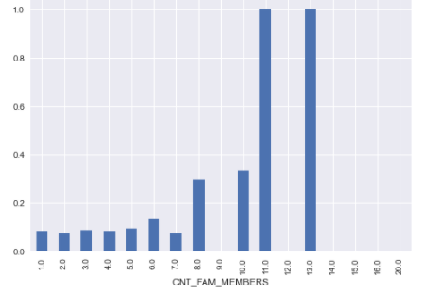
TARGET CATEGORY V/S COUNT OF FAMILY MEMBERS
The people having 11-13 family members are not able to pay loan installments on time an hence marked as defaulters.
The people having 1-7 family members are most likely to pay their installments on time.

Slide 24
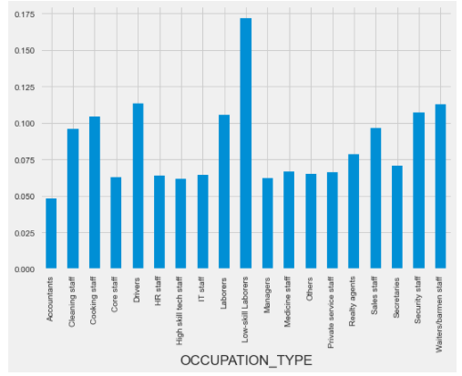
TARGET CATEGORY V/S OCCUPATION TYPE
The low-skill laborers were not able to make loan installments and hence marked as defaulters.
Accountants are likely to make their payments on time.

Slide 25
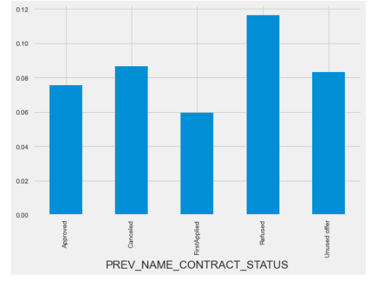
TARGET CATEGORY V/S CONTRACT STATUS
The candidates whose loan is approved are more to pay loan installments on time.
The people were refused for loan approval as they will default more.

Slide 26
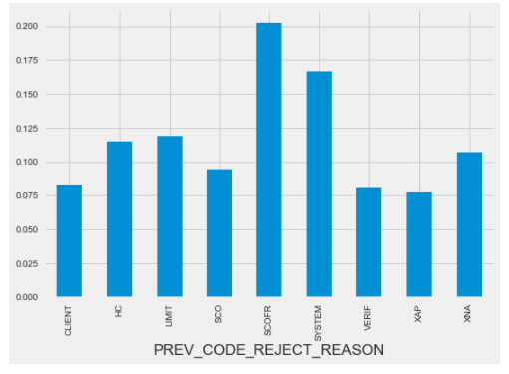
TARGET CATEGORY V/S REASONS FOR REJECTION
The major reason for rejection is SCOFR and system.

Slide 27
MULTIVARIATE ANALYSIS

Slide 28
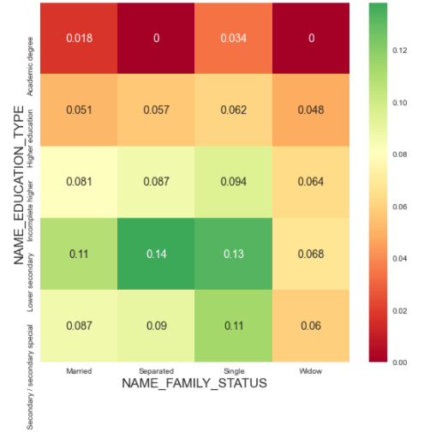
EDUCATION TYPE V/S FAMILY STATUS V/S TARGET
The single / separated with lower secondary education tends to default more.
The people having academic degree and who are single or widow are the safest group to provide loan .

Slide 29
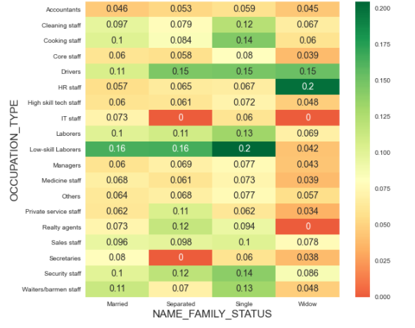
FAMILY STATUS V/S OCCUPATION TYPE V/S TARGET
The widow working in HR staff and single people who are low skill laborers tend to default more.
The widow and separated from IT staff , widow from realty agents and secretaries who are separated are safe to provide loan approvals.

Slide 30
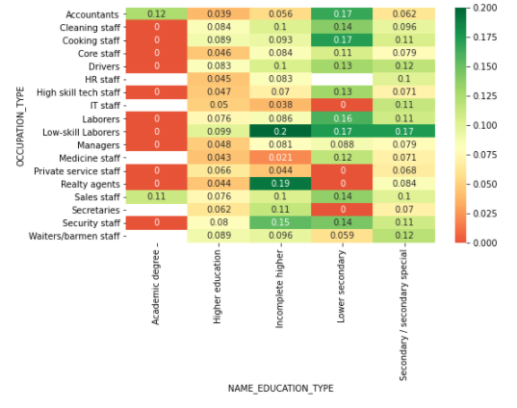
OCCUPATION TYPE V/S EDUCATION TYPE V/S TARGET
The people having incomplete higher education who are low skill laborers and realty agents tend to default more.
People having academic degree with any occupation are safest to give loans.

Slide 31
CORRELATION BETWEEN TARGET AND OTHER IMPORTANT NUMERIC VARIABLES

Slide 32
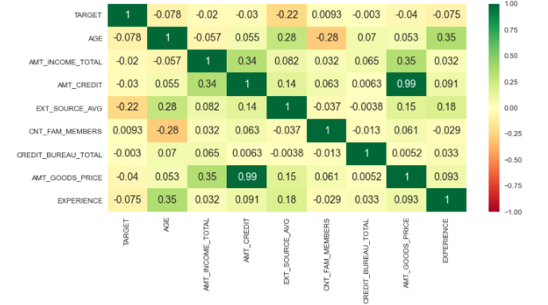
There is a high correlation between good price and amount credit in both previous and current application.
There is high correlation between

Slide 33
CONCLUSION
The categories which seems to be defaulters are as follows:-
Students/People less than age of 30
Low skill laborers who are widowed and single.
The people with incomplete higher education.
People having more than 10 family members.
The widow working in HR staff.

Slide 34
The safest categories to which bank can provide loan are :-
Females
People having academic degree
Old age people
Accountants
Educated Realty agents
IT staff
Married people

Slide 35
THANK YOU

